Slide 1
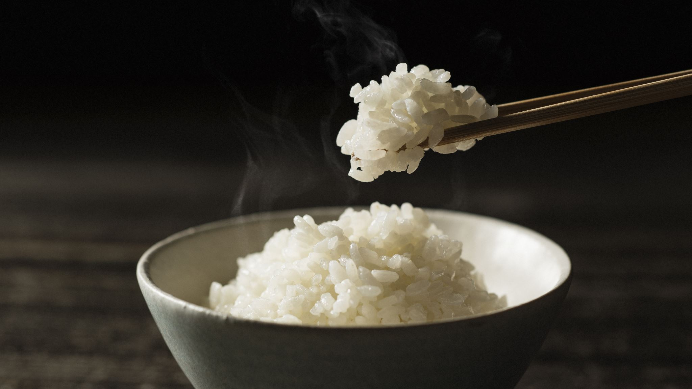
About cup-o-Rice
Team 2 presentation

Slide 2
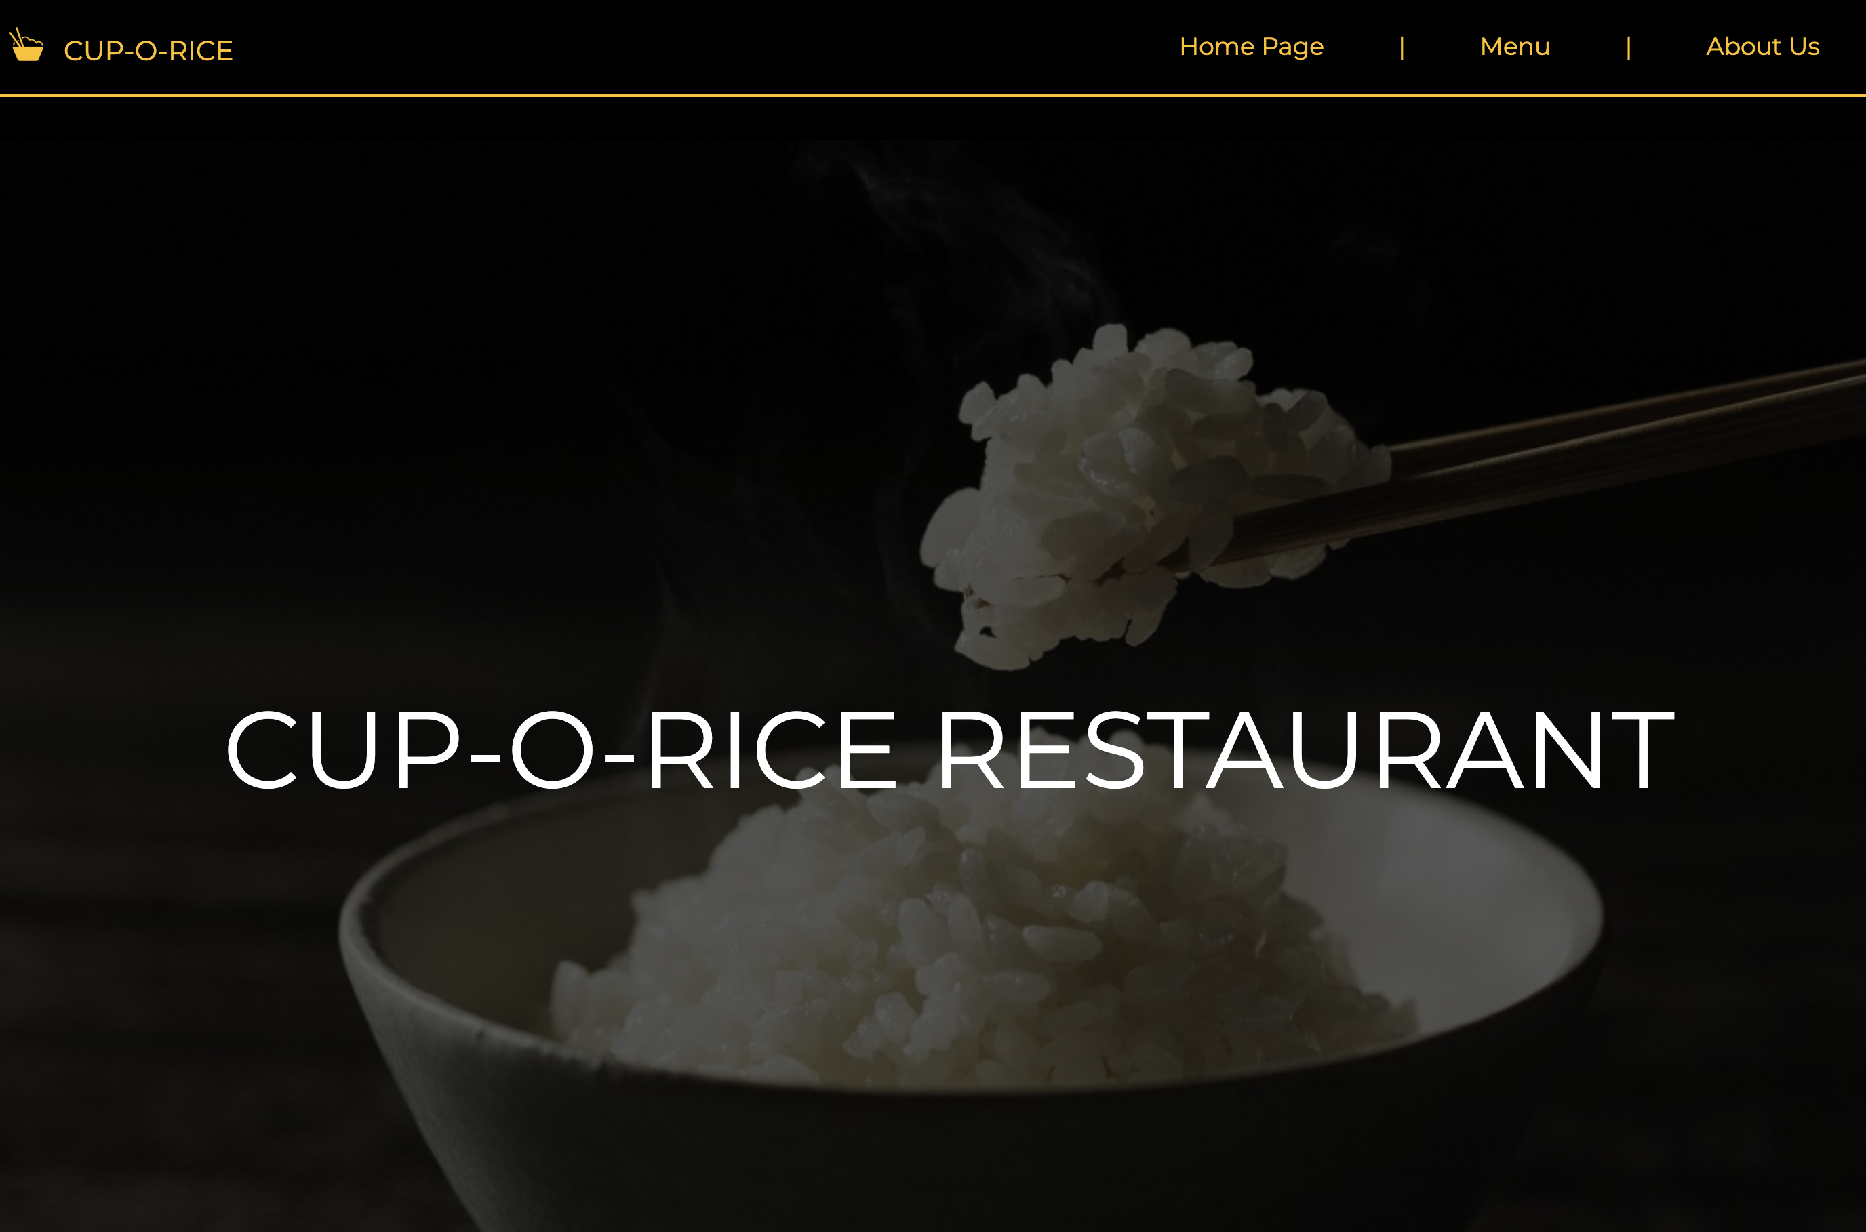
Cup-O-Rice Homepage
HMTL and CSS in collaboration with Mark and Sophie
Black and Yellow as main color scheme
Simple yet boldly eye-catching banner
Logo and restaurant name in line with the nav

Slide 3
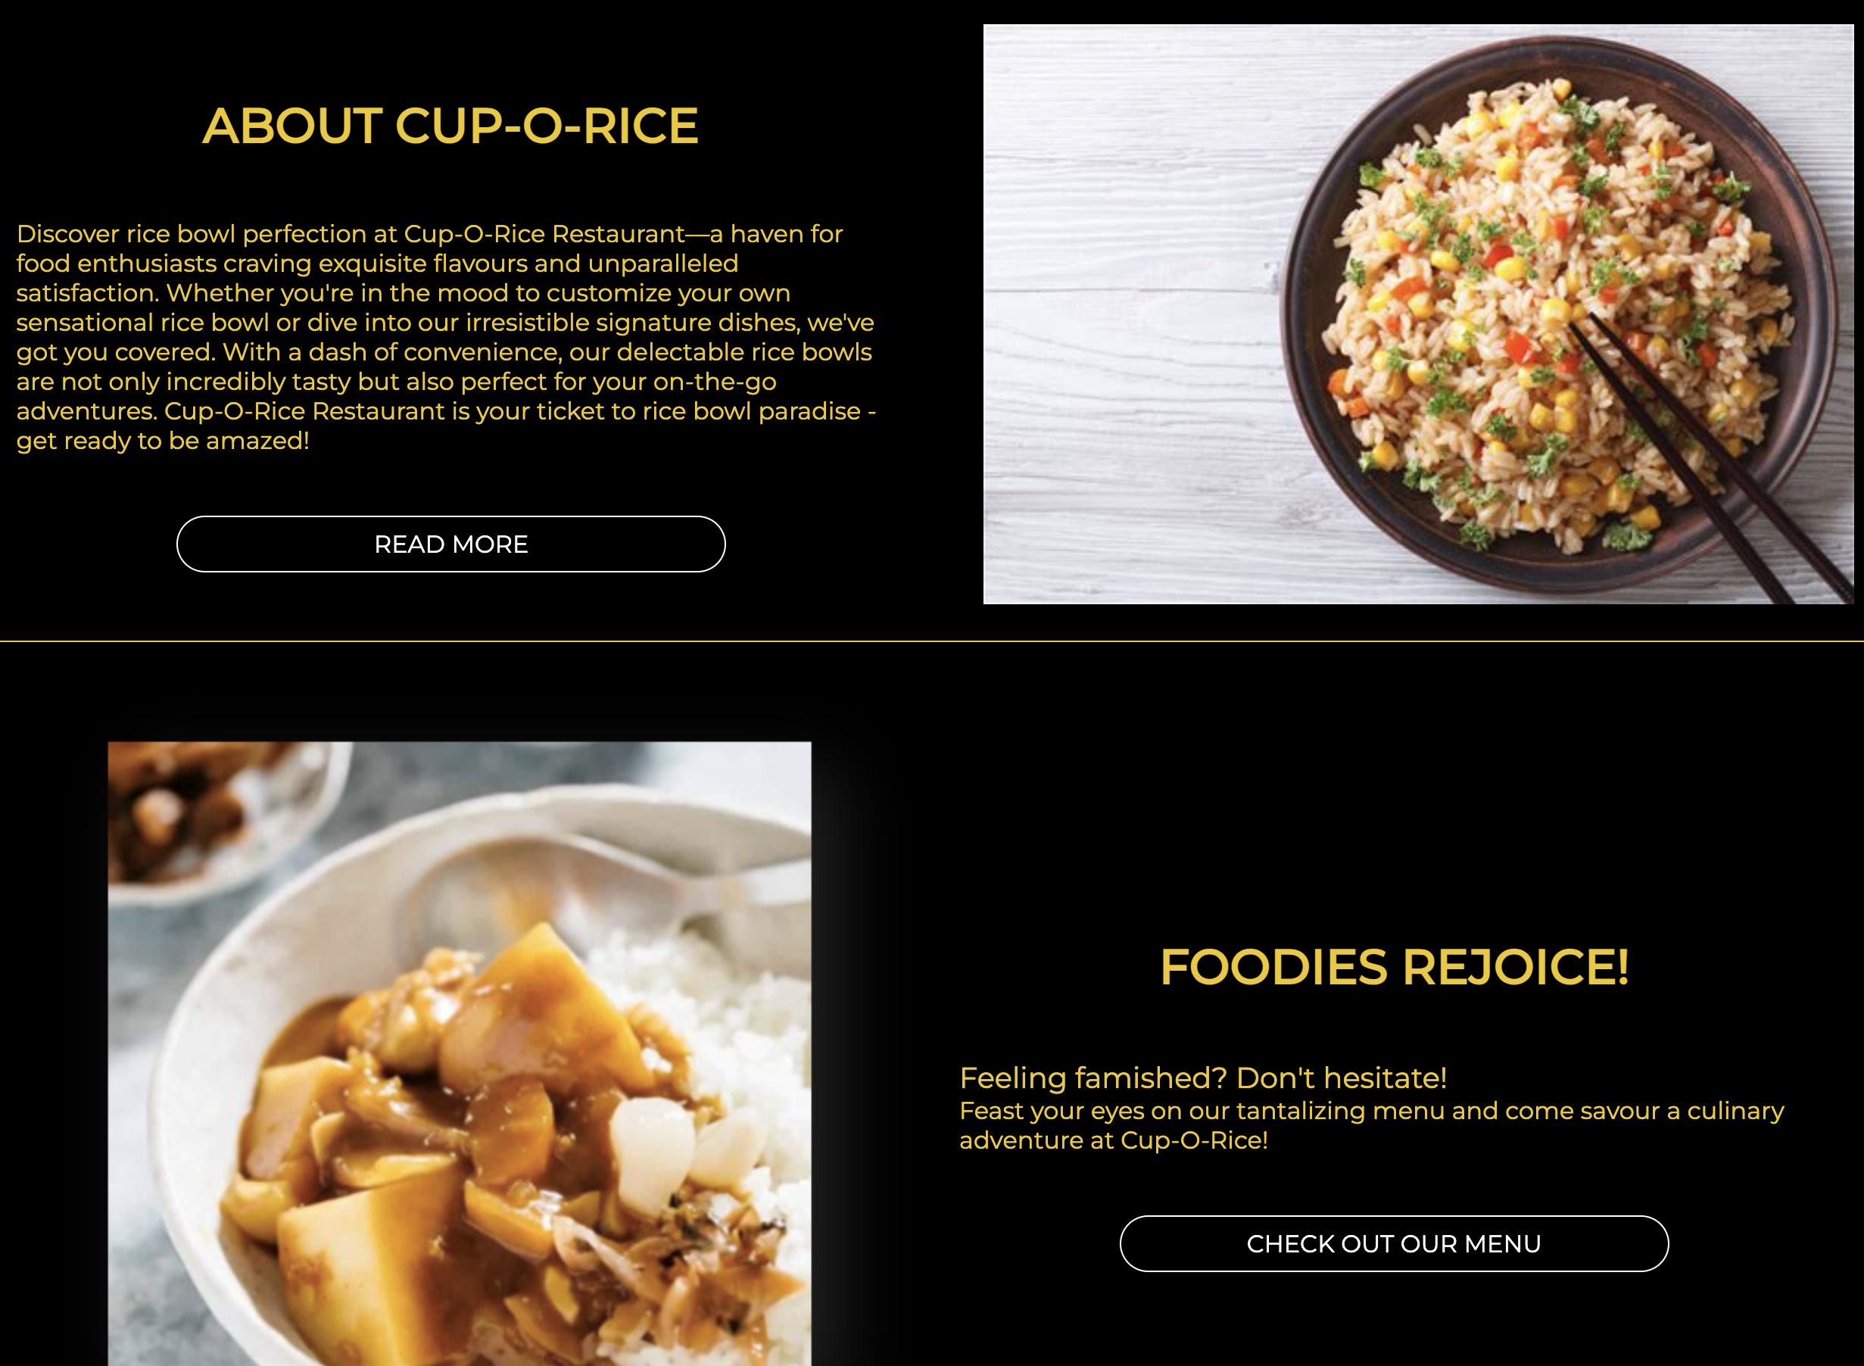
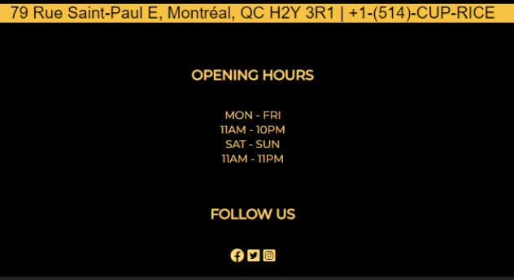
Deeper look into the homepage
Having a brief Cup-O-Rice restaurant description and a button linking to “about us” page
Foodies Rejoice section linking to the “Menu” page
Address and opening hour in the footer
Adding social media links in the footer to improve the website

Slide 4
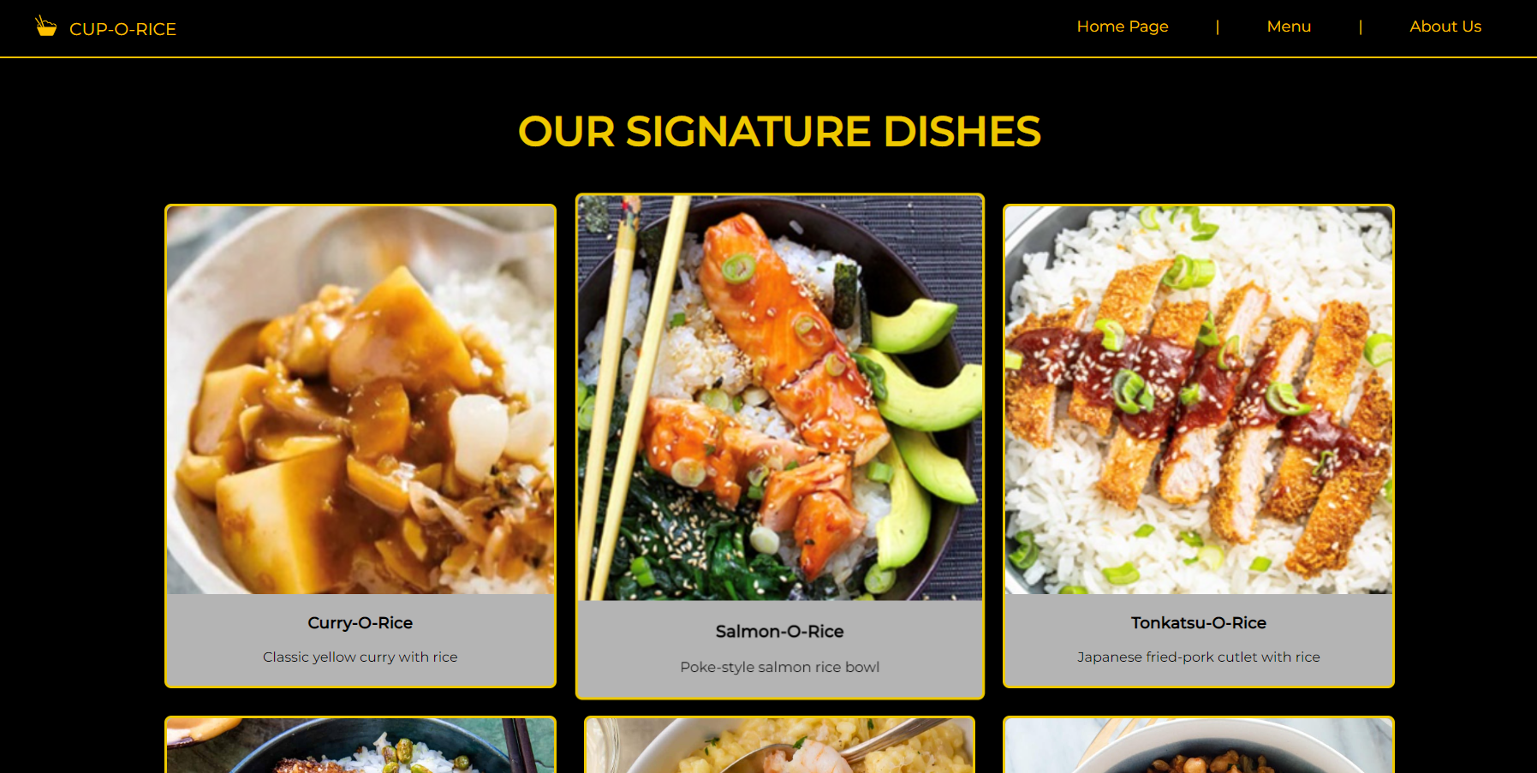
Menu Page

Slide 5
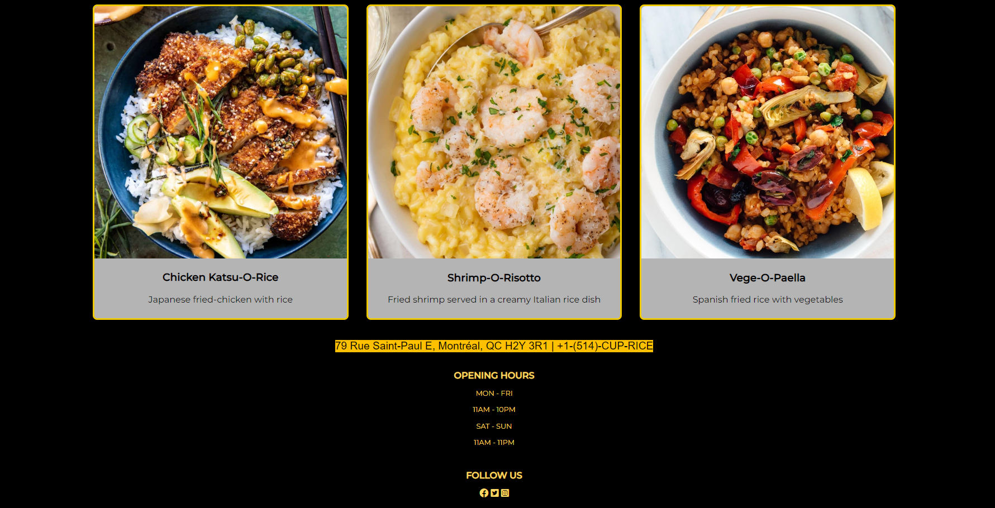
Deeper look into the Menu Page
Having a brief Cup-O-Rice restaurant description and a button linking to “about us” page
Foodies Rejoice section linking to the “Menu” page
Address and opening hour in the footer
Adding social media links in the footer to improve the website

Slide 6
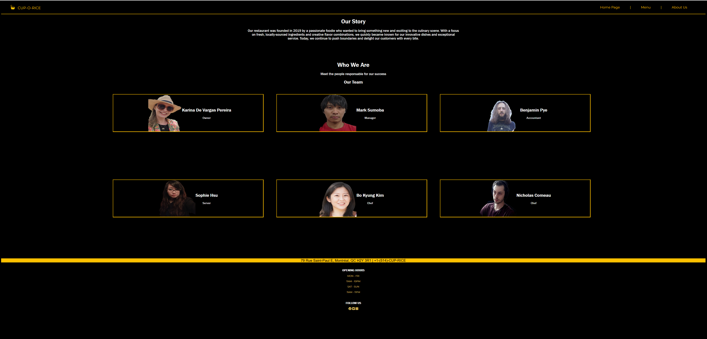
About Us Page

Slide 7
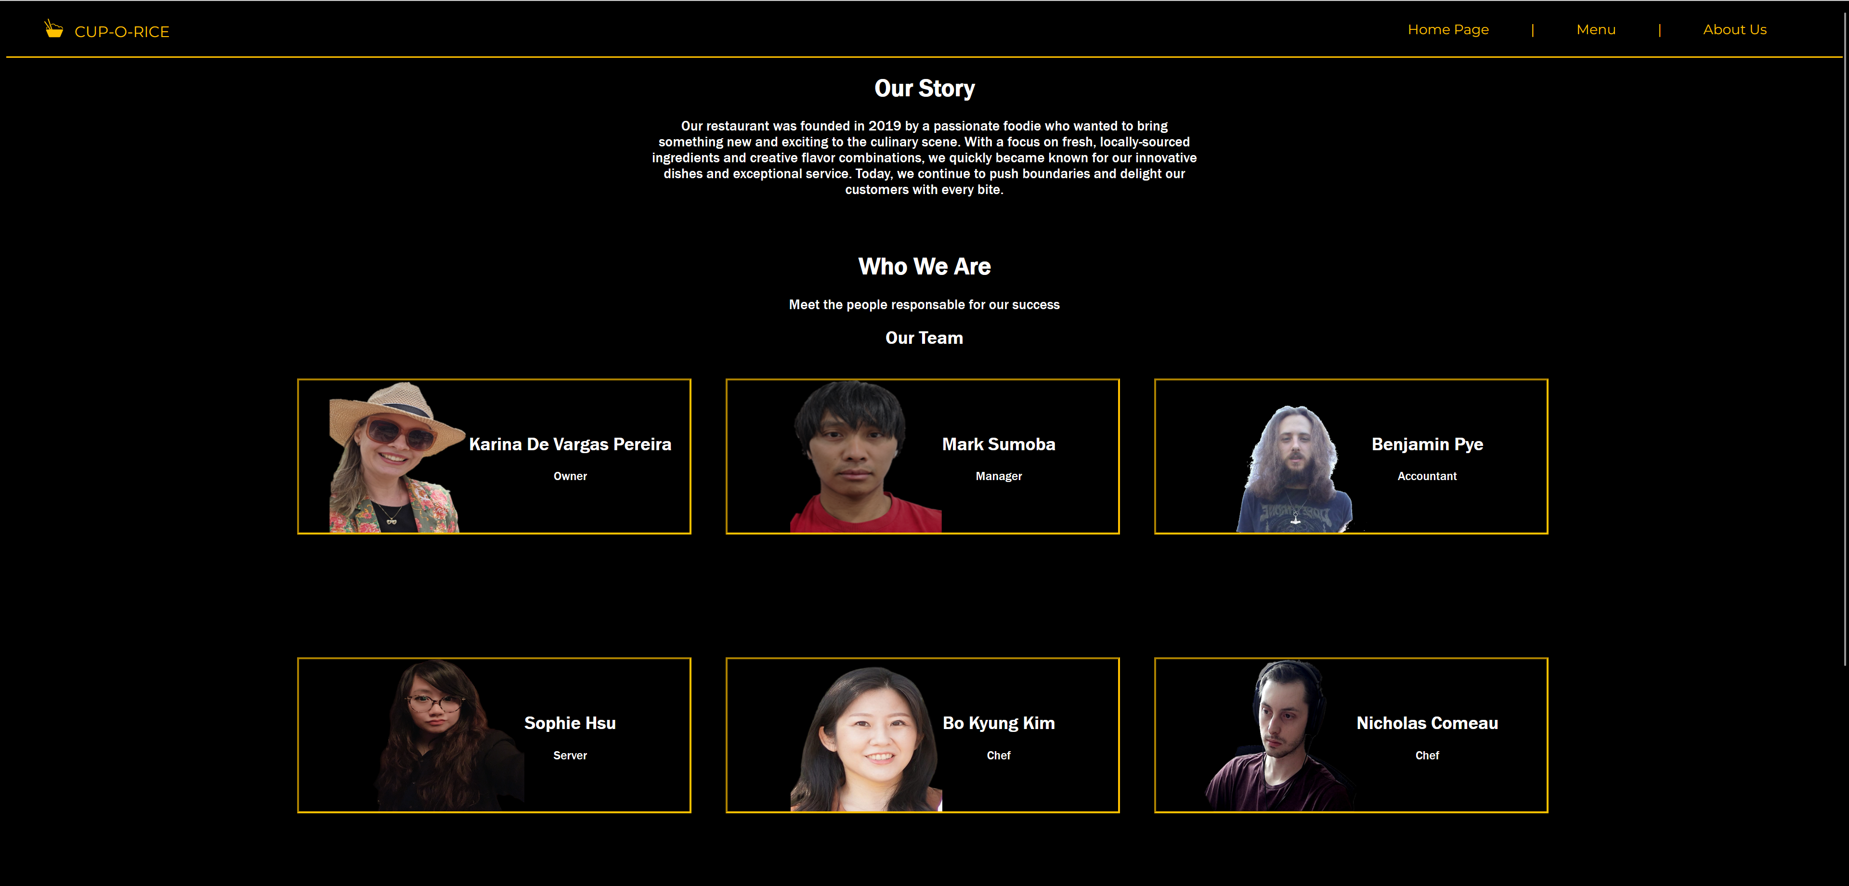
Deeper look into the About US Page
Having a brief text explaining Our Story
Presenting our team with pictures and job tiltes
Address and opening hour in the footer
Adding social media links in the footer to improve the website

Slide 8
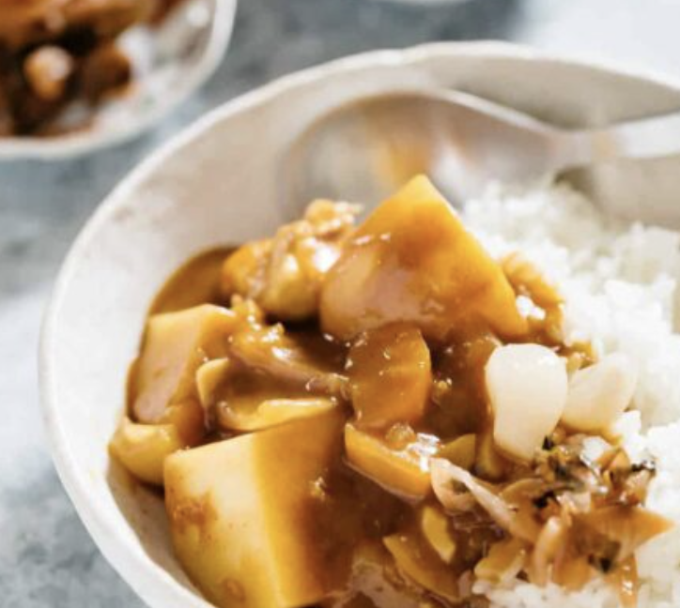
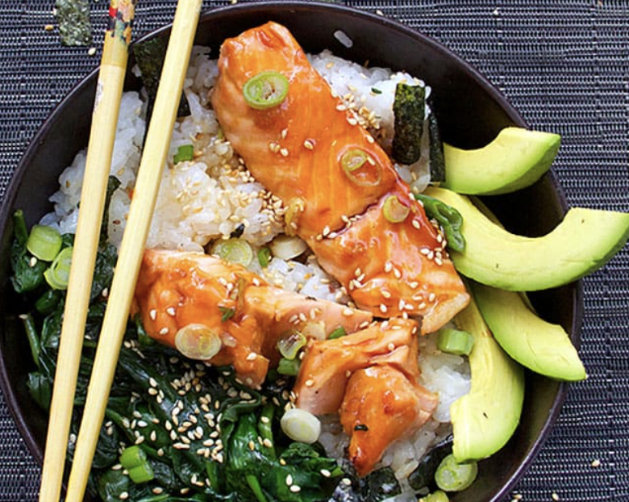
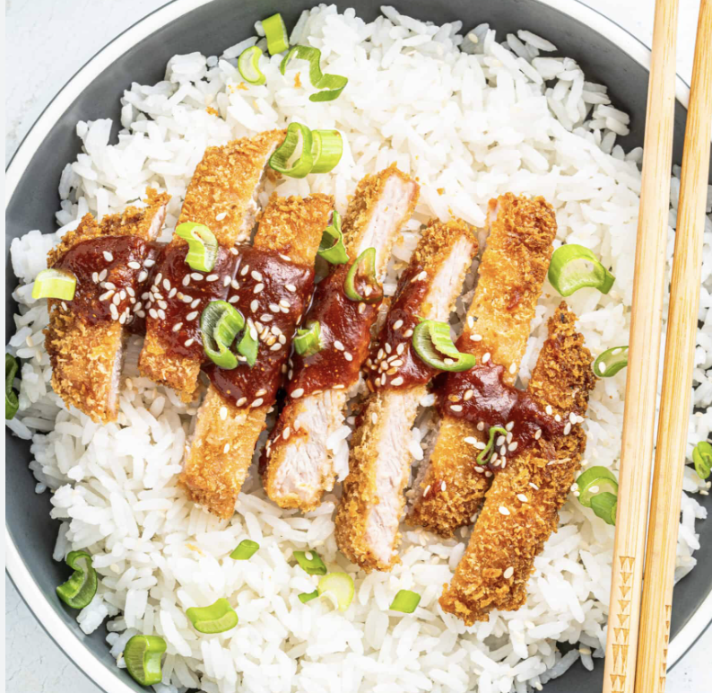
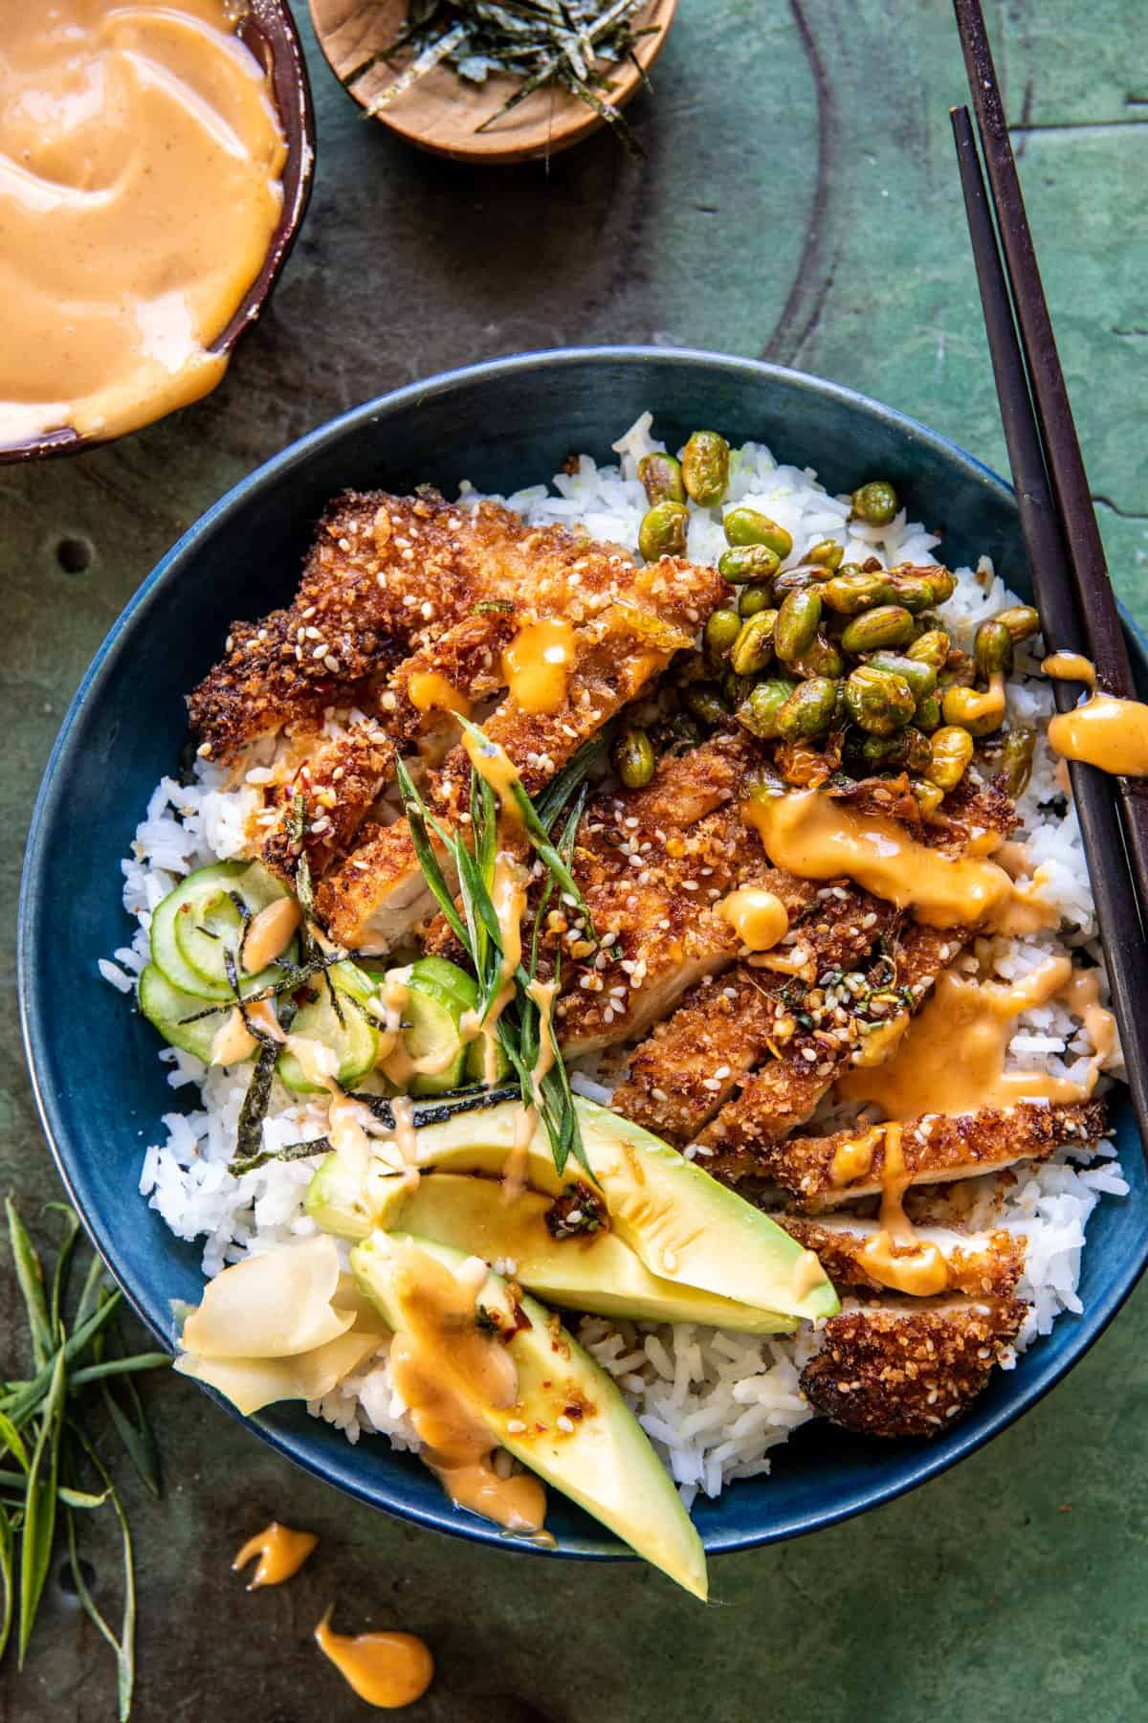
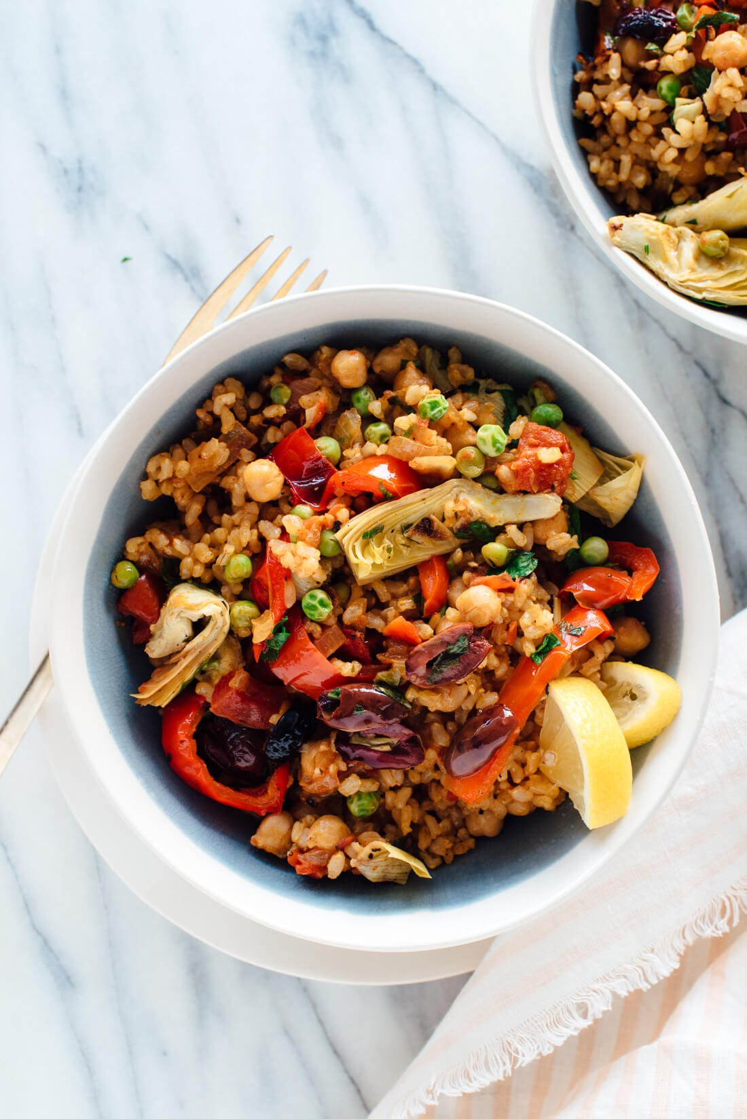
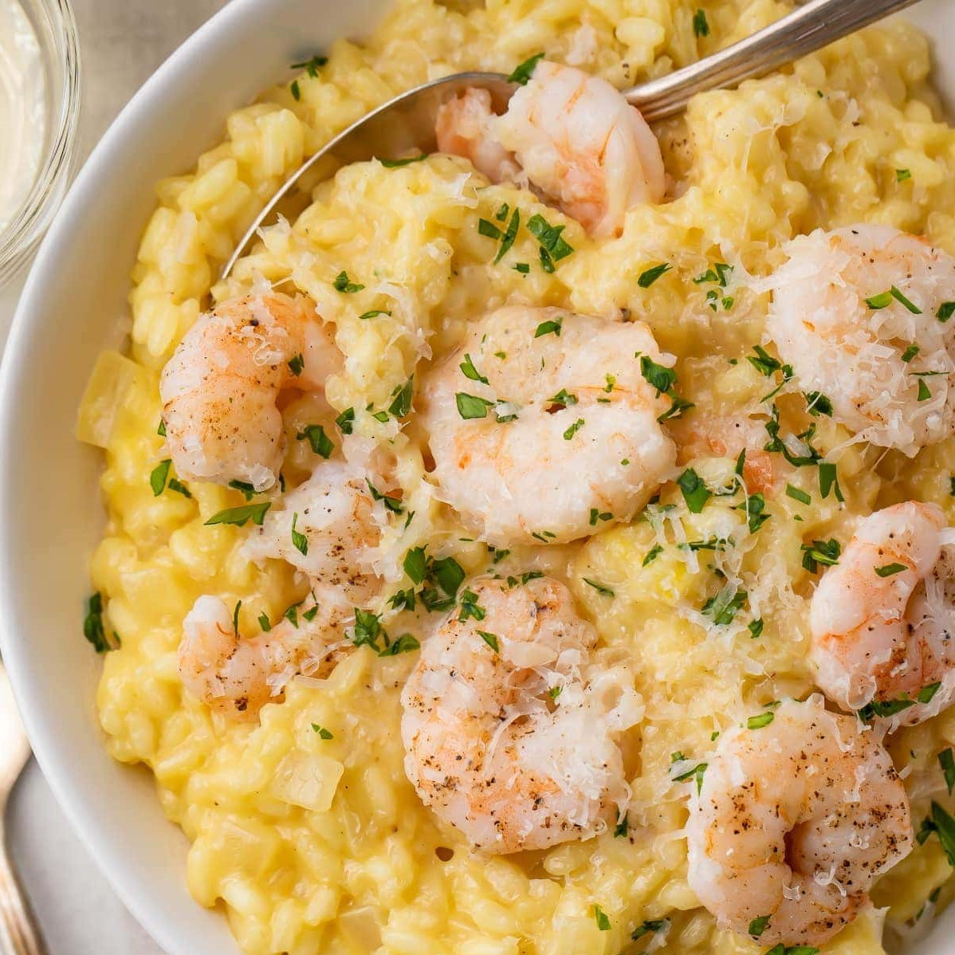
ONTO EACH SIGNATURE DISH

Slide 9
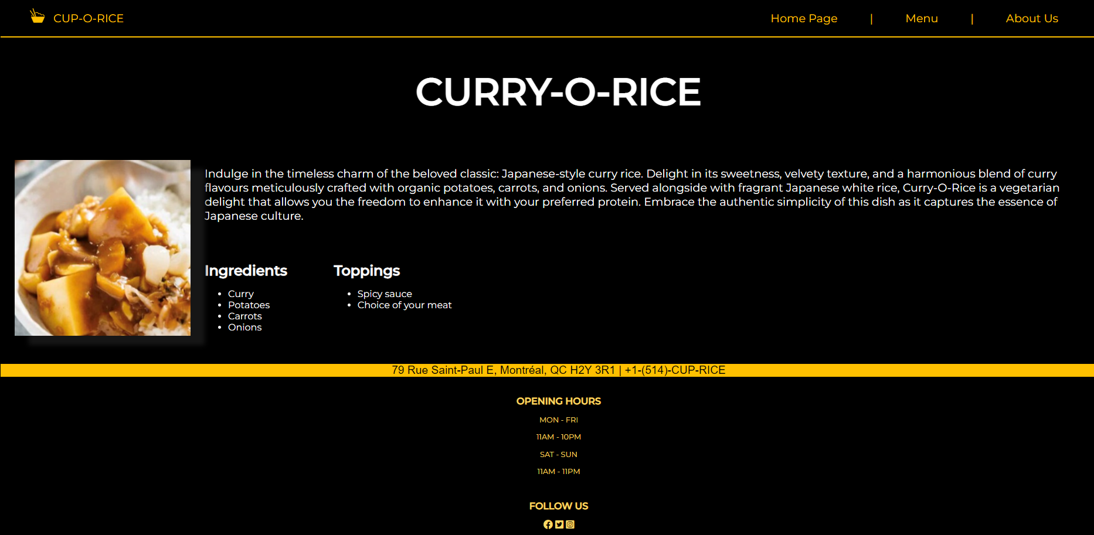
Specialty Dish #1: Curry-O-Rice
Standardized HTML and CSS
Keeping Nav the same style as the homepage
Maintaining Black and White color scheme
Specialty name on the H2
Arrange the Curry image on the left and text on the right

Slide 10
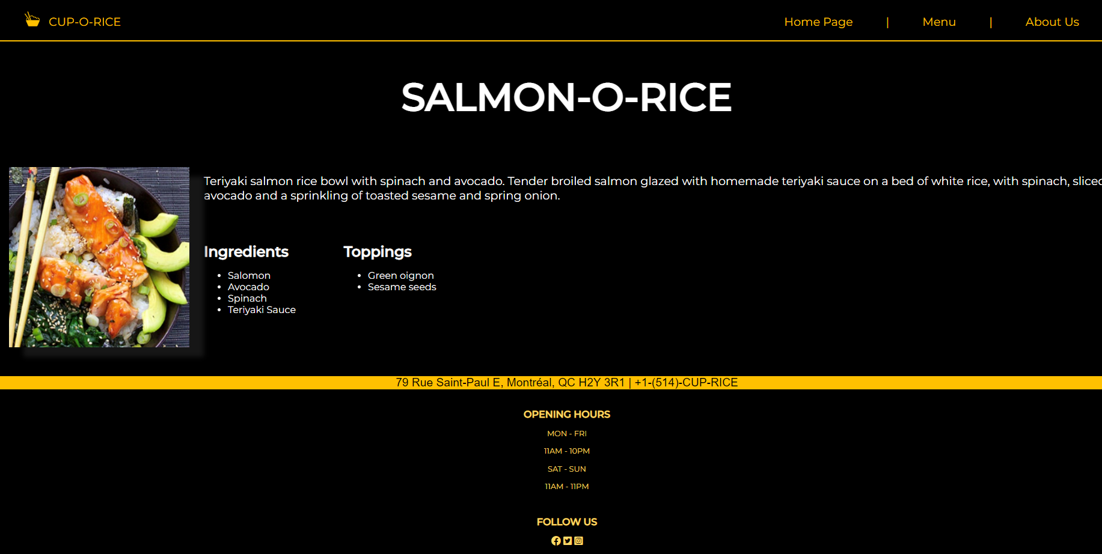
Specialty Dish #2: Salmon-O-Rice
Standardized HTML and CSS
Keeping Nav the same style as the homepage
Maintaining Black and White color scheme
Specialty name on the H2
Arrange the Curry image on the left and text on the right

Slide 11
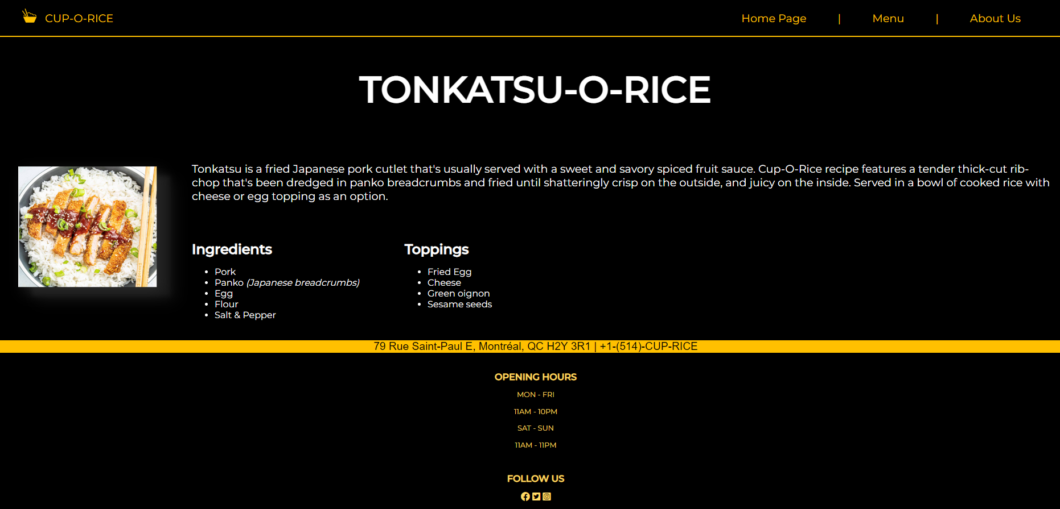
Specialty Dish #3: Tonkatsu-O-Rice
Standardized HTML and CSS
Keeping Nav the same style as the homepage
Maintaining Black and White color scheme
Specialty name on the H2
Arrange the Curry image on the left and text on the right

Slide 12
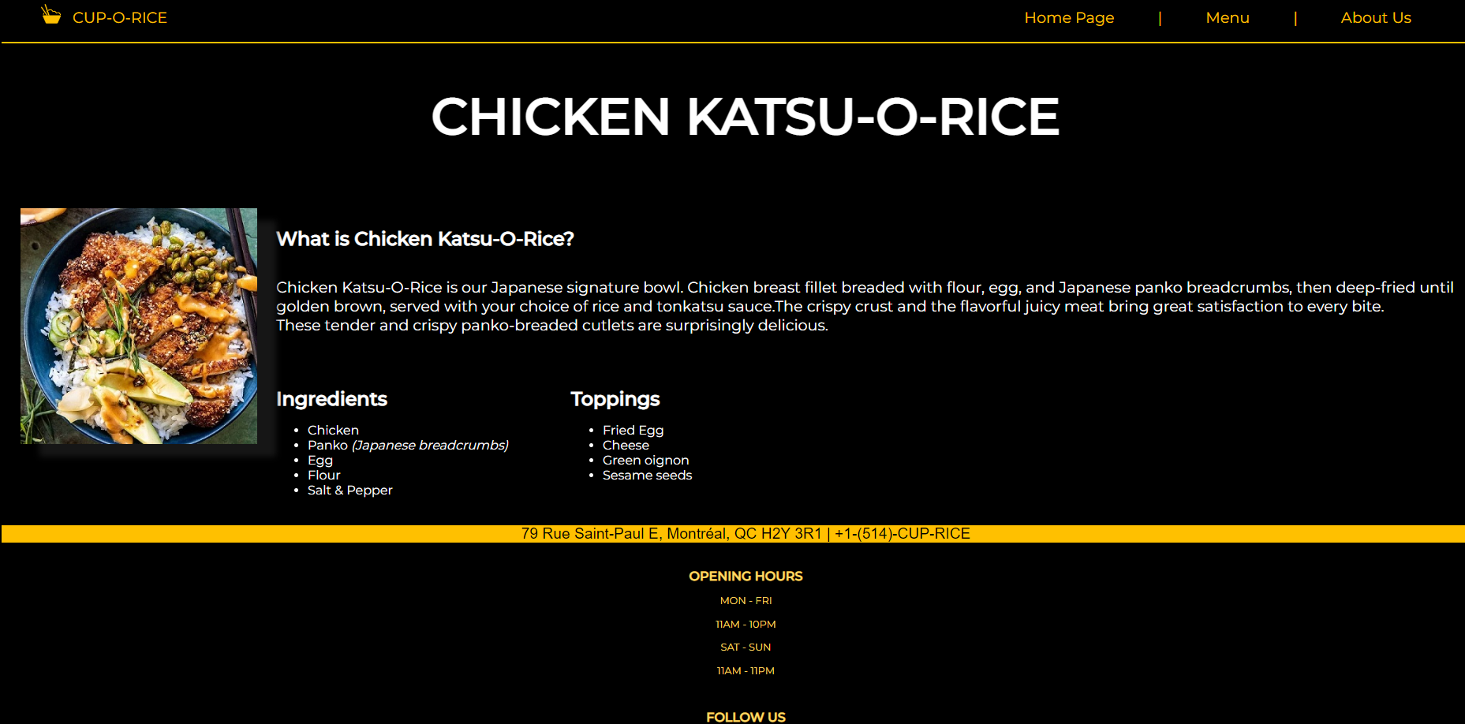
Specialty Dish #4: Chicken Katsu-O-Rice
Standardized HTML and CSS
Keeping Nav the same style as the homepage
Maintaining Black and White color scheme
Specialty name on the H2
Arrange the Curry image on the left and text on the right

Slide 13
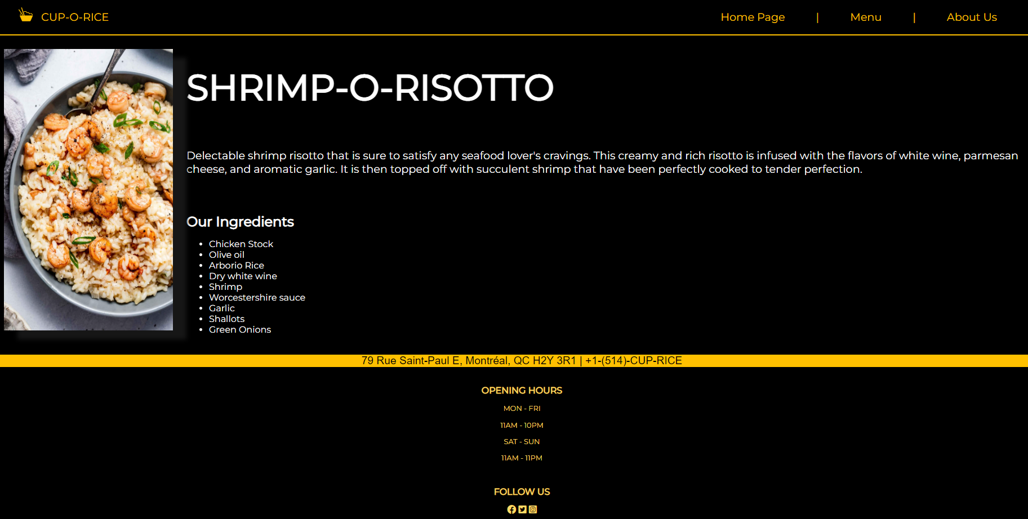
Specialty Dish #5: Shrimp-O-Risotto
Standardized HTML and CSS
Keeping Nav the same style as the homepage
Maintaining Black and White color scheme
Specialty name on the H2
Arrange the Curry image on the left and text on the right

Slide 14
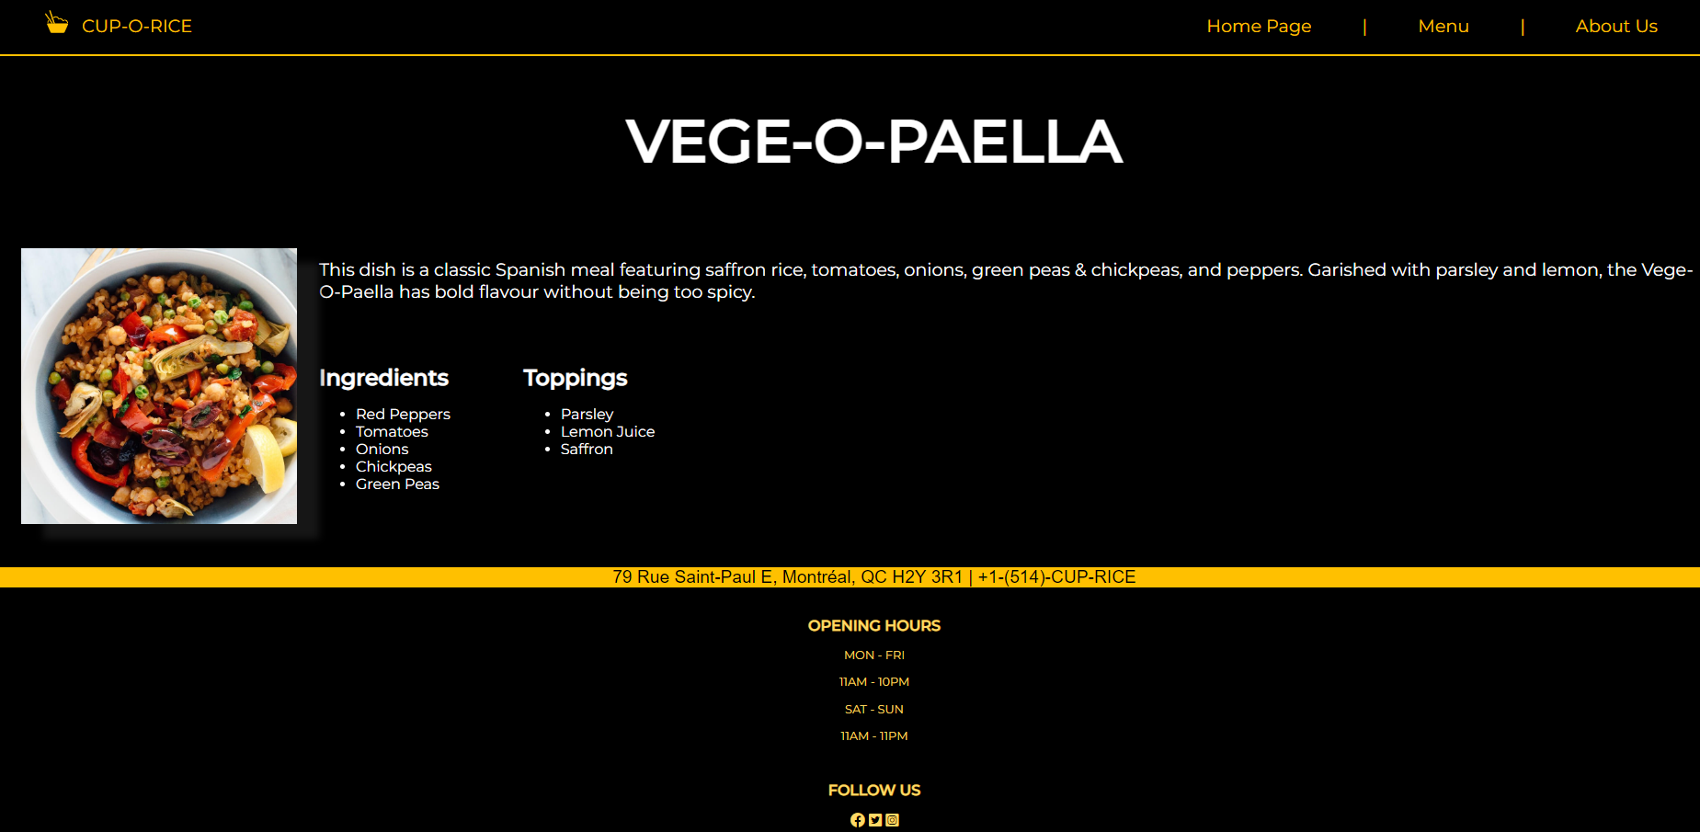
Specialty Dish #6: Vege-O-Paella
Standardized HTML and CSS
Keeping Nav the same style as the homepage
Maintaining Black and White color scheme
Specialty name on the H2
Arrange the Curry image on the left and text on the right

Slide 15
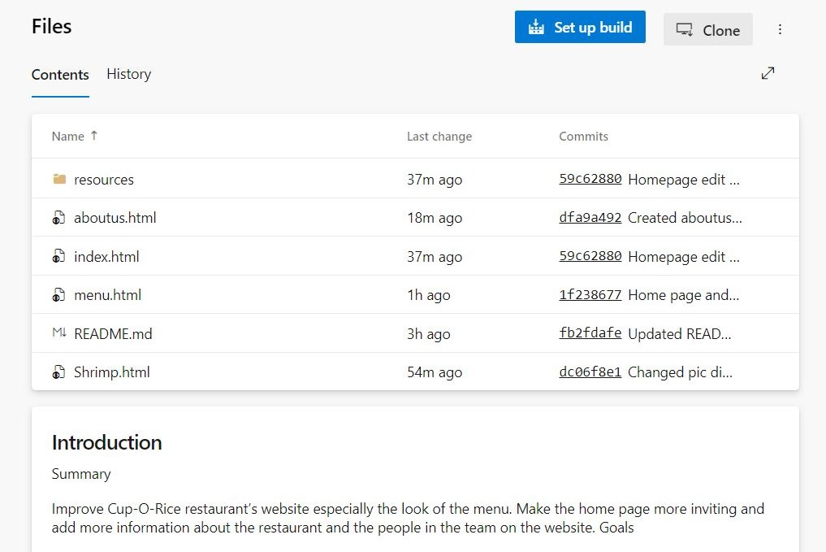
Team Repository Progression
June 2nd, 2023 – Friday 12pm

Slide 16
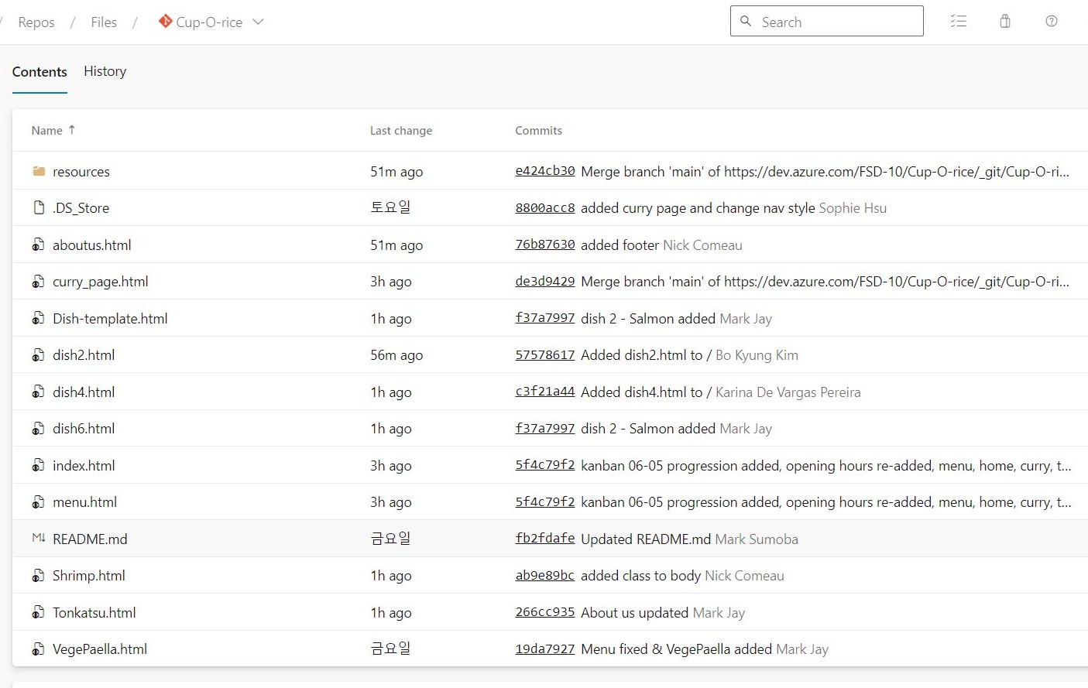
Team Repository Progression
June 5th, 2023 – Monday 10am

Slide 17
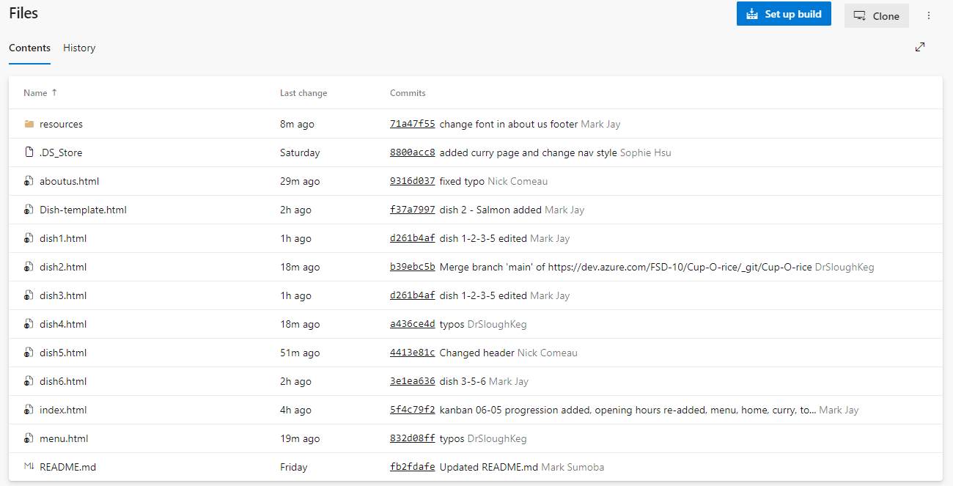
Team Repository Progression
June 5th, 2023 – Monday 12pm

Slide 18
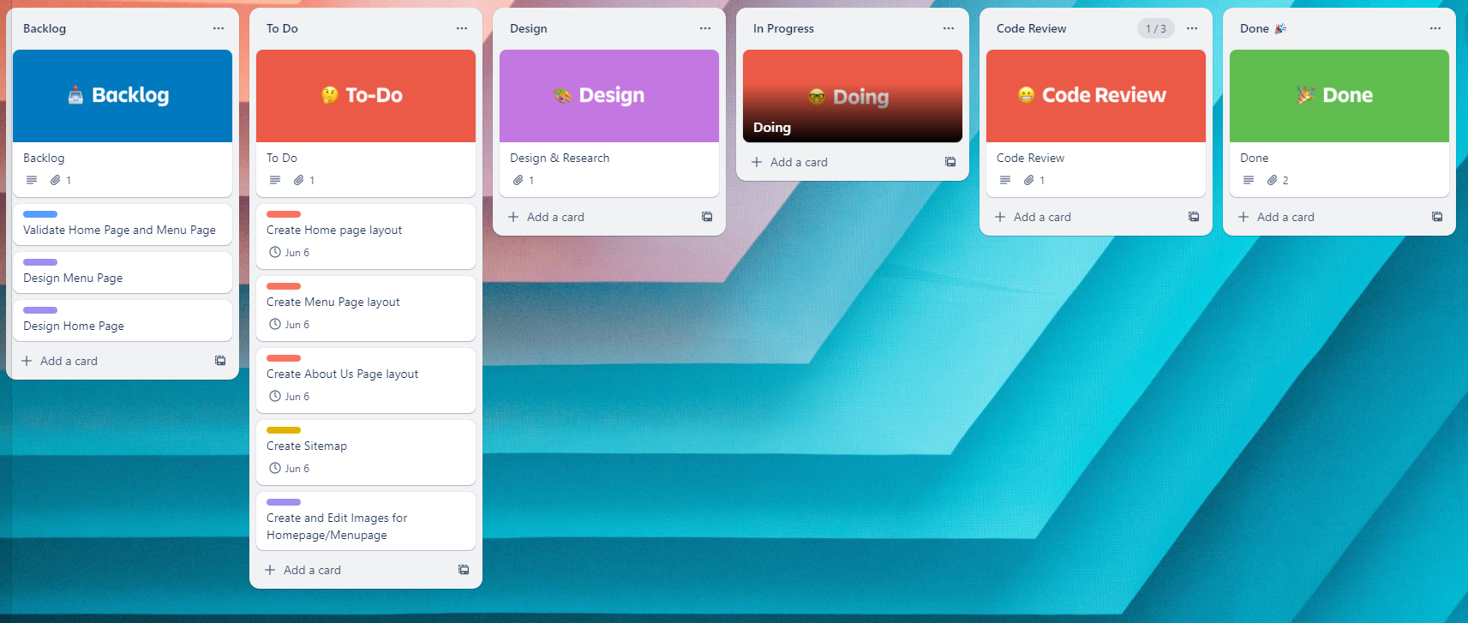
Trello Progression
June 2nd, 2023 – Friday

Slide 19
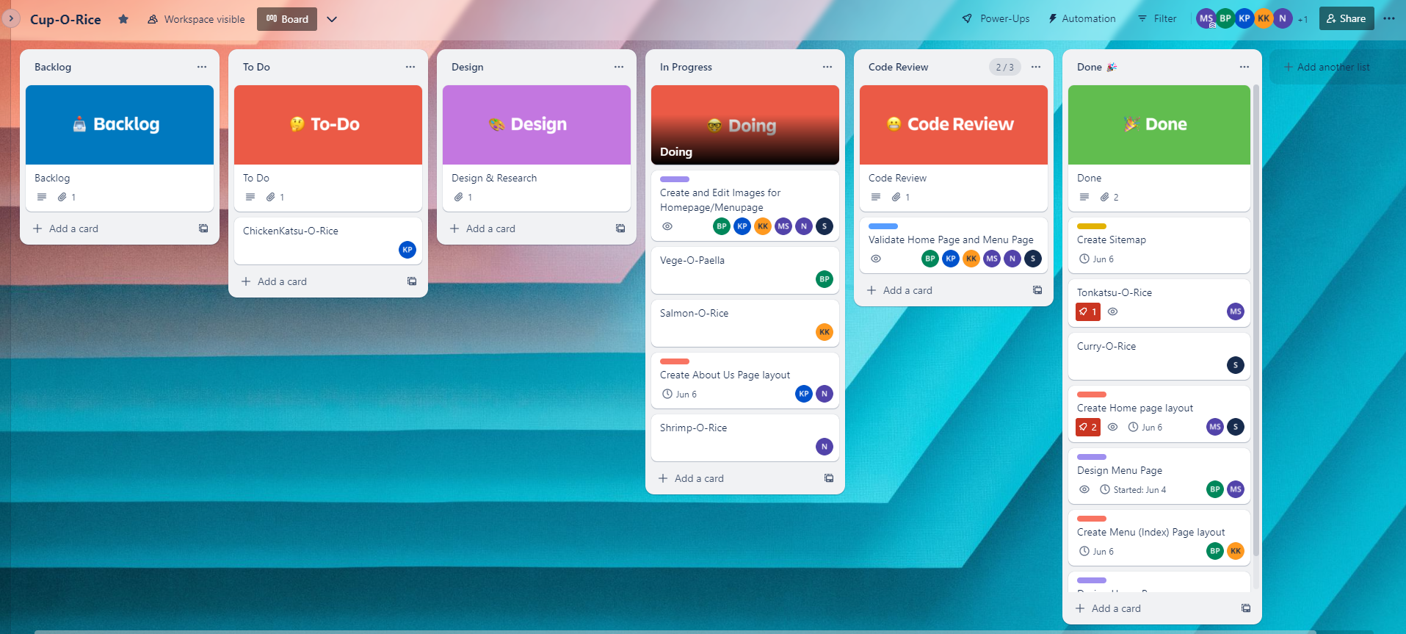
Trello Progression
June 5th, 2023 – Monday

Slide 20
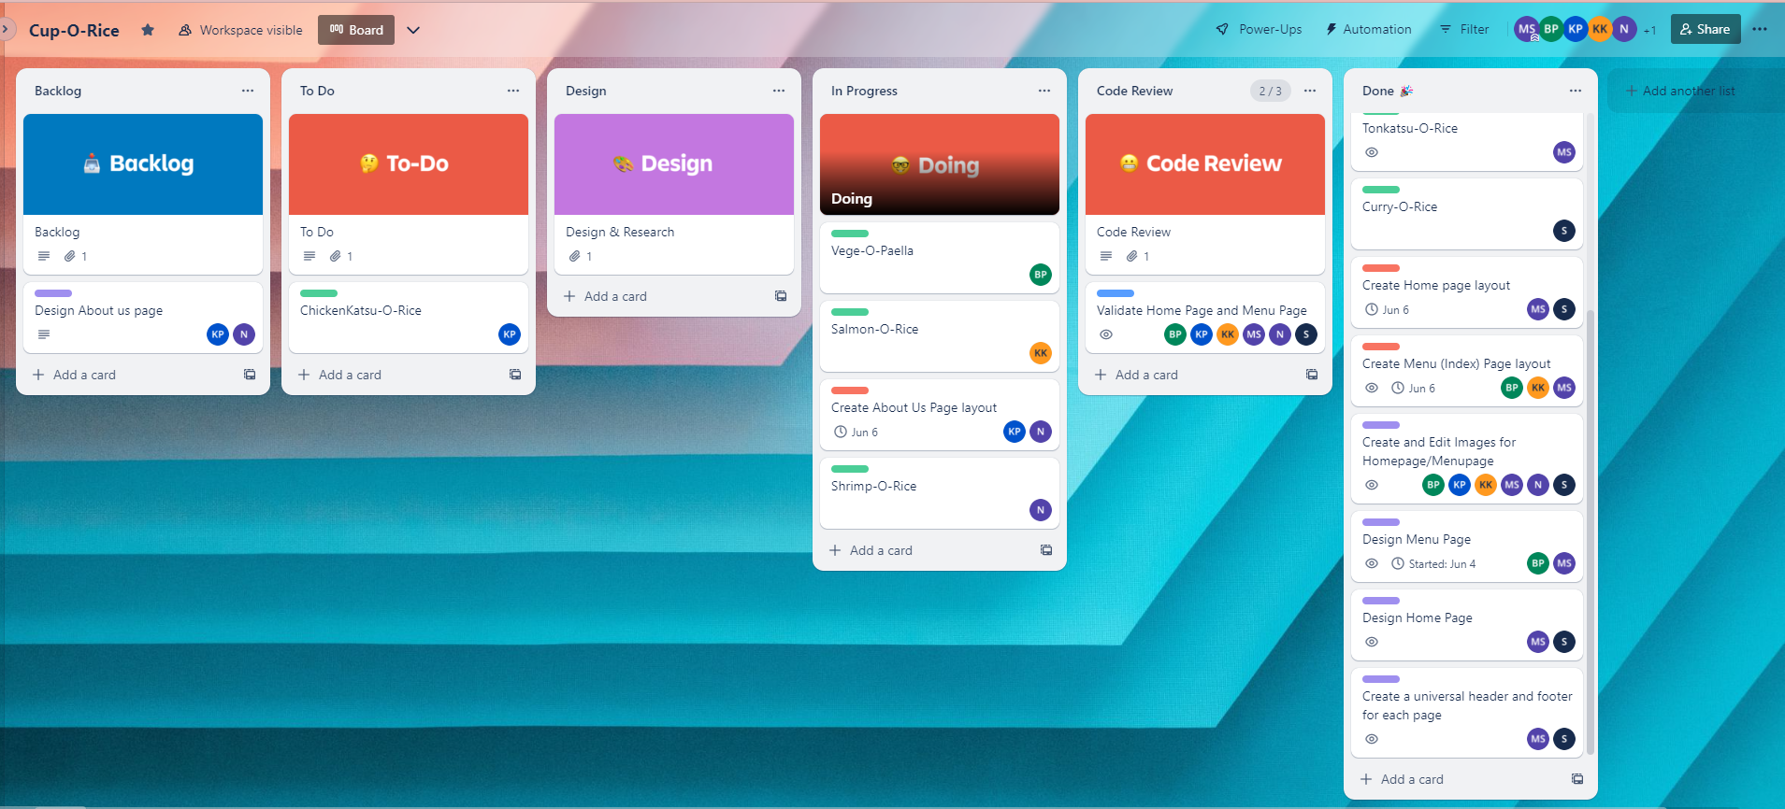
Trello Progression
June 5th, 2023 – Monday

Slide 21
Thank you

